Slide 1
READDLE
Team Details:
Tanisha (2310990982)
Tanisha Bansal (2310990983)
Sanskar Mishra (2310991353)
Submitted To : Mr. Aman Rajak
:
Chitkara University Institute of Engineering and Technology,
Chitkara University, Punjab

Slide 2
Table of Contents
Introduction
Problem Statement
Key Features
Website Layout
Future Scope
References/Links used

Slide 3
Introduction
READDLE, your ultimate destination for in-depth book reviews and literary exploration. Our website is created from a deep love for literature and a desire to create a vibrant community where readers can discover, discuss, and explore the world of books. Our mission is to bring you comprehensive, insightful, and honest reviews that help you navigate the vast world of literature. Book review websites have emerged as essential hubs for readers seeking recommendations, reviews, and community engagement

Slide 4
Problem Statement
You might be wondering what makes us so special compared to other websites. Readdle is a user-friendly website focused on book recommendations that would best fit your unique tastes and preferences. While most book review websites have very bland layouts, our website is among those that are eye-catching, yet personalized in recommending books according to your mood for the day. Our goal to provide raw, untouched reviews to readers of the books. While other sites would ask you to buy or invest in a book without showing any of the content inside; on our site, we provide sample pages for our readers to glance at and reach a decision on whether to invest in a certain book or not. Hence, a reader may develop an interest in reading a book and make more informed decisions.

Slide 5
Key Features
User-Friendly Design: It is designed with an intuitive interface, making it easy to navigate. This enriches user experience and makes it quite easy for any user to search through and explore book reviews based on their interests.
Personalized Book Recommendations: Personalized suggestions based on individual user preferences, moods, and reading history, ensuring that every visitor finds books that matches with their unique tastes.
Visually Appealing Layout: An eye-catching design that stands out from conventional book review sites, enhancing user enjoyment and encouraging longer browsing sessions.
Dedicated Sections for Different Genres: Organized categories for various genres, making it easy for readers to find reviews and recommendations based on their favorite literary styles.

Slide 6
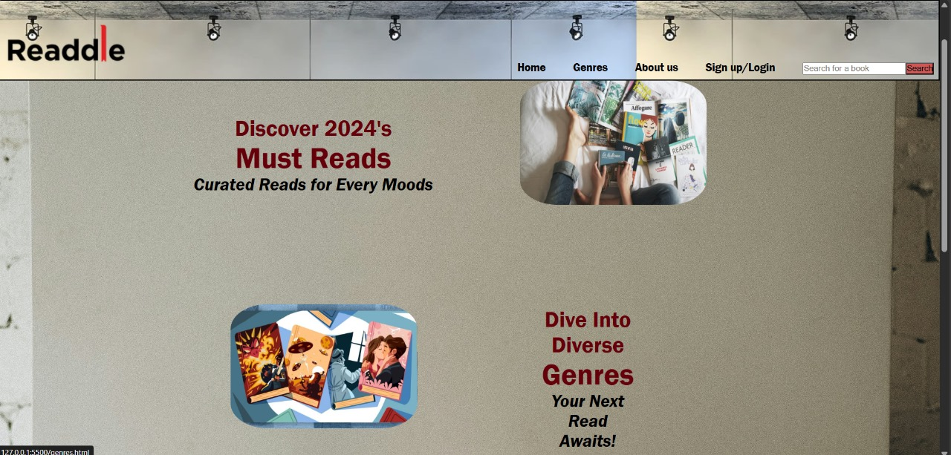
Website Layout

Slide 7
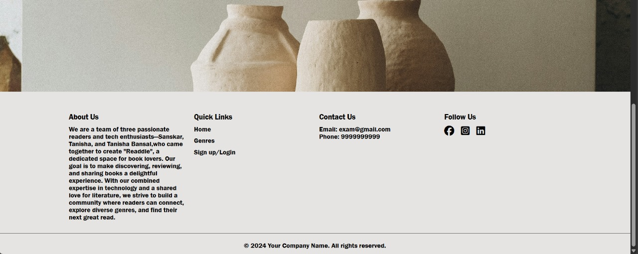
Website Layout

Slide 8
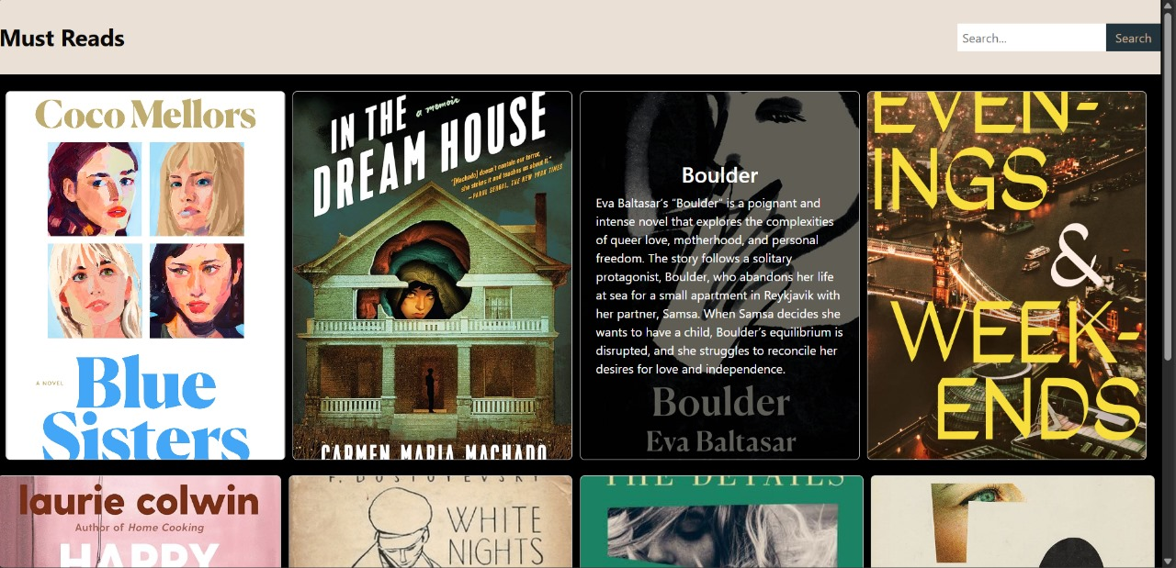
Website Layout

Slide 9
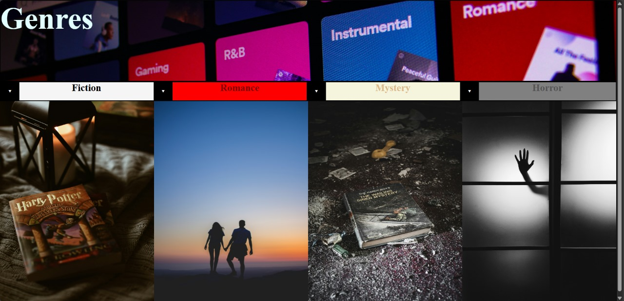
Website Layout

Slide 10
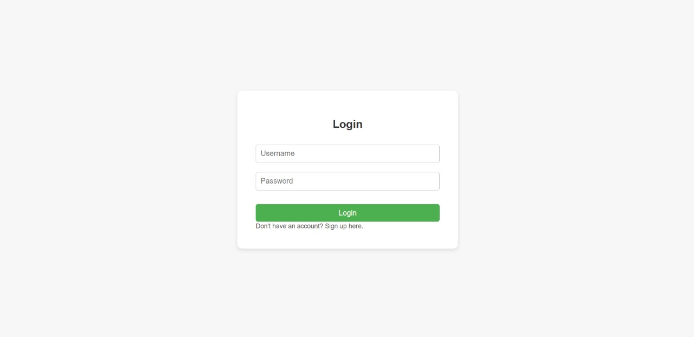
Website Layout

Slide 11
Future Scope
As a matter of fact, there are several ways that this website will see improvement in the near future. Among others, we intend to provide a venue where readers of similar tastes can communicate and discuss books featured on our site. This will offer the author real and useful feedback about their work. Also, we want this to be a friendly platform for young writers looking to publish their books, but so far haven't found a proper venue to do it. That way, readers will be able to read modern literature while authors will earn money and get motivated to continue with their creative work. We also intend to include a membership feature that would allow dedicated readers access to special editions of books from different authors. In addition, the provision for membership will also include connecting readers with similar tastes to form their own clubs or groups for connectivity and personalized updates.

Slide 12
References/Links used
https://www.goodreads.com/
https://www.amazon.com/b?node=154606011
https://www.youtube.com/

Slide 13


